Slide 1
Sweet Trends Team: Stock Trend ETL Process
Extract
Retrieve list of trending stock tickers for 10 regions
Transform
Convert timestamp and startintervals to db readable formats
Load
Import extracted tables to Postgres
Pull detailed quote data for tickers identified
Find 10-year History (open/close/high/low/volume) of the tickers
Reduce quote data attributes to only those needed to answer our questions
Import reduced tables to Postgres

Slide 2
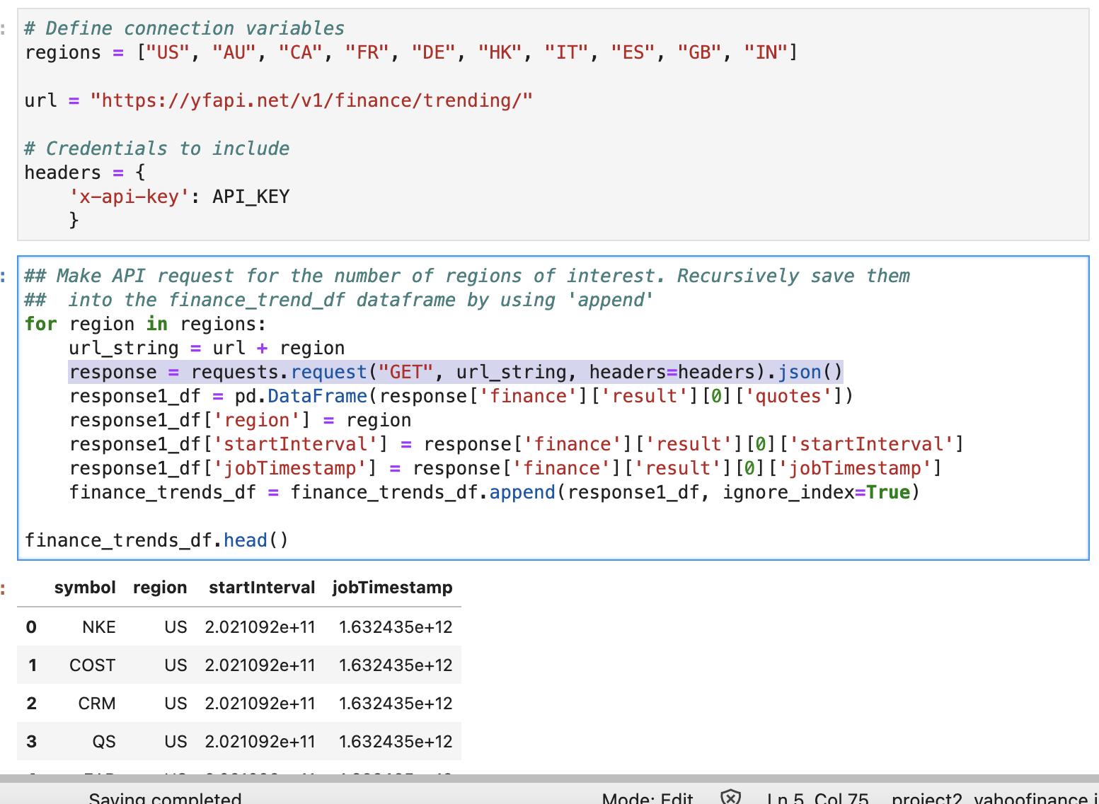
Extract Example: API to DataFrame

Slide 3
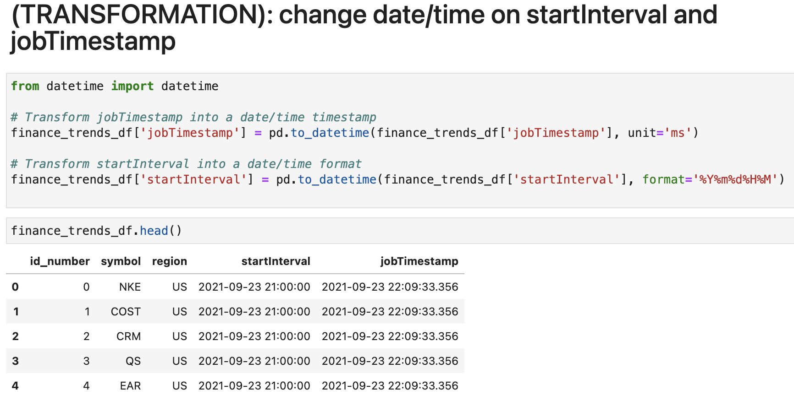
Transformation Example:

Slide 4
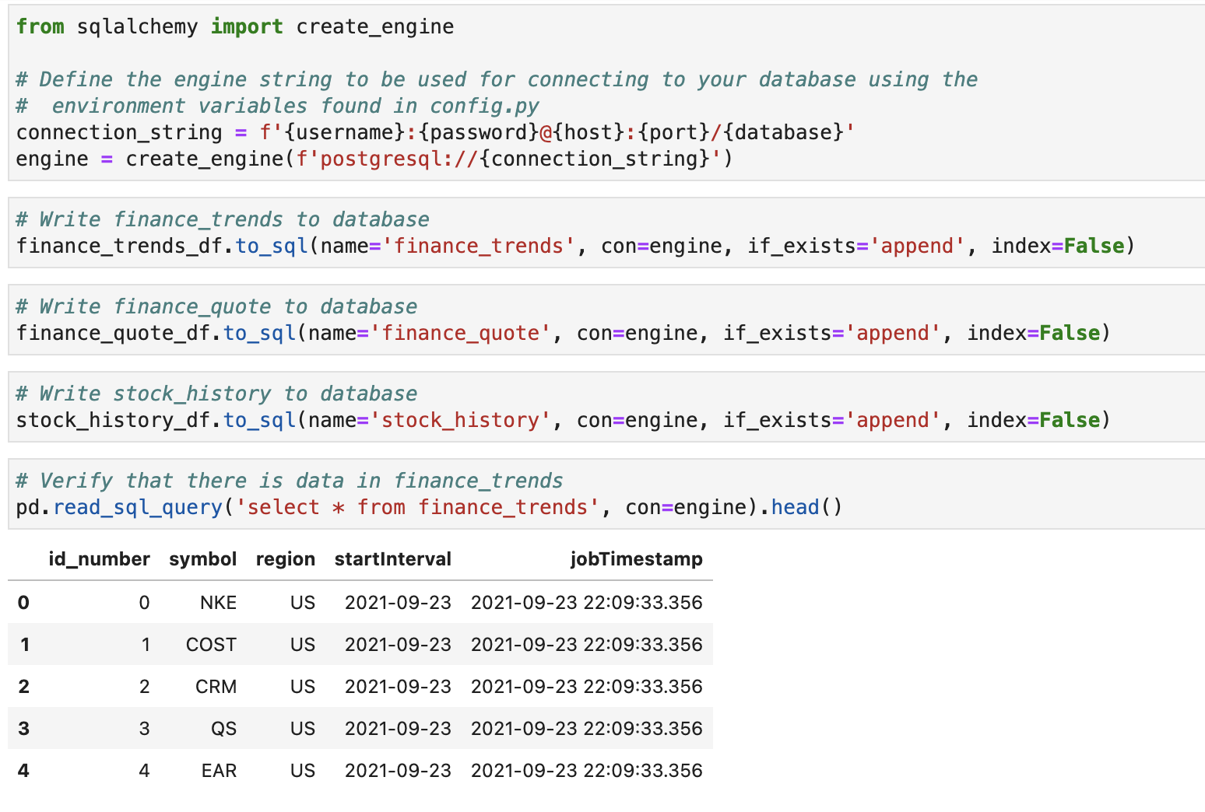
Load Example: DataFrame to PostgreSQL

